Slide 1
Read 3 - 4 chapters of the Bible per day
plus devotional commentary
Daily Prayer sentence
Weekly Summary of the scripture story
Grasp the grand sweep of the Scriptures
Develop a daily spiritual discipline
and stronger devotional life
View life through the lens of scripture
Draw guidance and insight for your daily life
Participate in weekly, monthly,
and/or occasional gatherings

Slide 2
Say Yes to the Challenge!
Yes, I want to deepen my walk with Christ
Yes, I want to grasp the Grand Sweep of Scripture
Yes, I want to listen and respond to God’s call

Slide 3
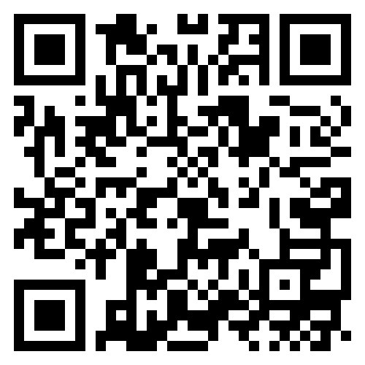
How to Say Yes:
Scan the QR code you see here, in the bulletin or newsletter, or on our Facebook page, or
Send an email to martha@stmarkstn.org, or
Call the church office at (615) 893-3455.
Friends, Relatives, Acquaintances, & Neighbors
are welcome to participate!

Slide 5
Small Groups Available
Sundays, 9:15 – 10:15 a.m. beginning January 7th, especially for adults not currently members of another Christian education class. Led by Revs. Tommy Ward and Martha Touchton.
Sundays, 4:00 – 5:00 p.m. beginning January 7th. Led by Hannah Pratt.
Wednesdays, 6:00 – 7:00 p.m. beginning January 3rd. Led by a team of St. Mark’s retired clergy.
Fridays, 10:00 – 11:00 a.m. beginning January 5th. Led by Claudia Hunter.
Register for a Small Group today!

Slide 6
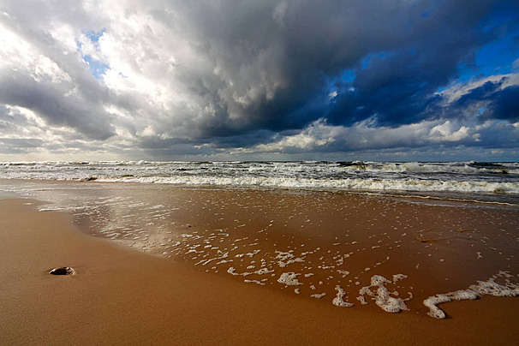
the
GRAND
Sweep
BIBLE CHALLENGE 2024

