Slide 1


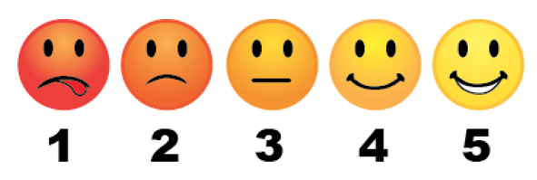
I rate my understanding of an abuse prevention ministry…

Slide 2

Safer Sanctuaries:
Train the Trainer
Rev. Dr. Kevin Johnson
Director, Children’s Ministries
UMC Discipleship
kjohnson@UMCdiscipleship.org

Slide 3

www.upperroom.org/safersanctuaries

Slide 4
Prayer
Gracious and most merciful God, you have brought us together in witness to your love of all children, youth, and vulnerable adults. Open our hearts and minds in this moment and prepare us to receive your message. Show us your will and fill us to overflowing with courage to face the reality of abuse. Give us energy and dedication enough to make this, your church, a holy and hallowed place where all your children may be safe and secure as they grow in faith and in their knowledge of your presence in their lives! Amen.

Slide 5
Matthew 25:37b-39
‘when did we see you hungry and feed you? When did we see you thirsty and give you something to drink? 38 When did we see you as a stranger and invite you in? When did we see you needing clothes and give them to you? 39 When did we see you sick or in prison and go to visit you?’

Slide 6
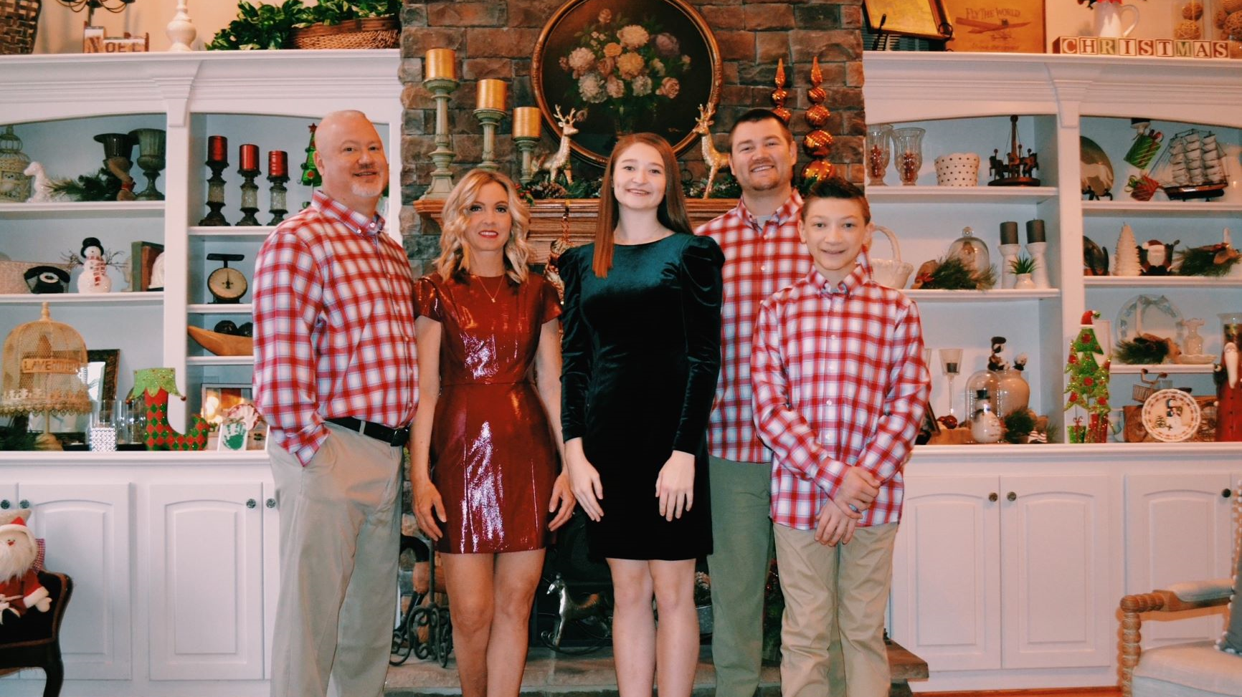

Slide 7
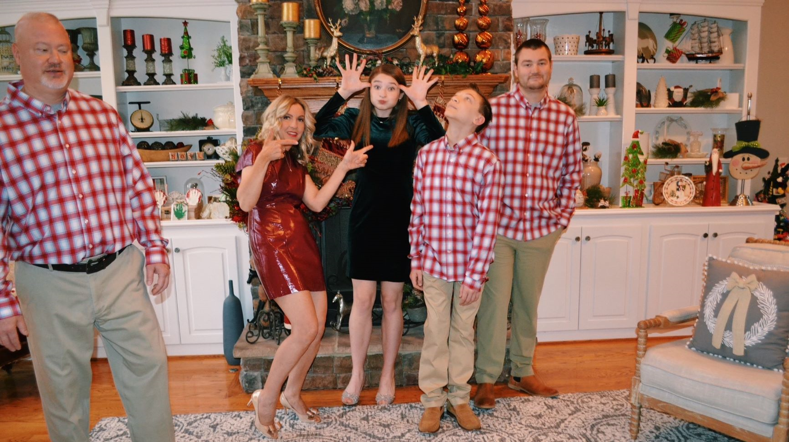

Slide 8
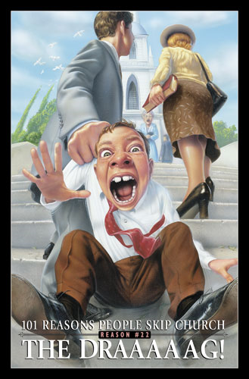

Slide 9
Introduction
Giving us a Reason: Moving from fear to flourish. Seeing Safer Sanctuaries as a ministry opportunity

Slide 10
WONDER
Why does the church need a Safe Sanctuary policy to connect to God?

Slide 11
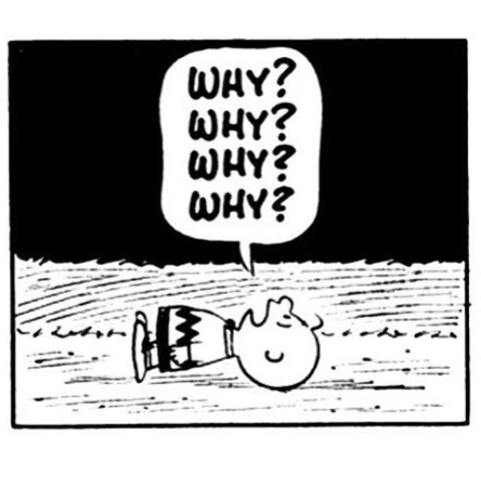

Knowing your “why”

Slide 12

Why are we here?
Notes:
Let me ask you a question and I want you to answer honestly. Why are you taking this training? Why have you given up some of your valuable time to and energy to complete this training. Take a few seconds now and jot down a few reasons why you are here.
(one minute timer)

Slide 13

We have to be here – Courtney made me.
We might get sued.
Our insurance threatened to drop us.
I don’t know why – this is stupid!
Notes:
Maybe you don’t really want to complete this training, you were told by a pastor or someone in your church that you had to complete Safer Sanctuary training– and it is true. This training is required by your annual conference, your district and by the local church. It is important that all volunteers who work with children youth and vulnerable adults be trained in best practices.
Another reason to complete the training are legal concerns, churches who have not competed any form of training have a lower likelihood of being successful in court if charges are filed or a lawsuit occurs. Insurance companies are also more likely to drop churches who have no Safer Sanctuary policy.
And then you may fall in the category of people who simply do not want to complete this training, and you think it’s stupid. If that is you, it’s okay. I appreciate your honestly but ask you to learn what you can and keep an open mind.

Slide 14

We want to keep everyone safe.
We made a baptismal commitment.
It is a communal act.
It make us better.
We love and care about everyone in our church.
This Photo by Unknown Author is licensed under CC BY
This Photo by Unknown Author is licensed under CC BY
Notes:
While there may be some negative reasons for Safer Sanctuary training there are a lot of positive reasons to participate as well. Safety should be a primary concern of every church. It is important that everyone, particularly our children youth and vulnerable adults, be safe. Would you take a child to a church if you knew the child would not be safe?
When a child comes before us for baptism, we make a commitment to be active participants in their faith journey, this includes providing them with a safe and nurturing environment.
We also need to remember that a person’s faith journey is not just the responsibility of a pastor or key volunteers. It is everyone’s job in the faith community to work together to ensure the safety of children youth and vulnerable adults.
This training will hopefully make us a better church, bring awareness to areas of safety we may often overlook and helping us see the perspectives of others.
Last, but certainly not least: We love and care about everyone in our church. Safety is one of many ways a church expresses their love to their members.

Slide 15
Remember your Baptism

Slide 16
With God’s help we will proclaim the good news and live according to the example of Christ. We will surround these persons with a community of love and forgiveness, that they may grow in their service to others. We will pray for them, that they may be true disciples who walk in the way that leads to life.

Slide 17


Slide 18
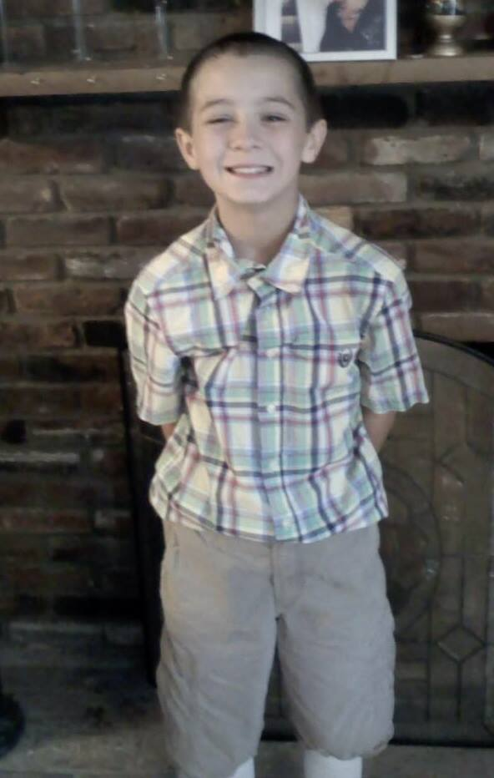
My “Why”

Slide 19
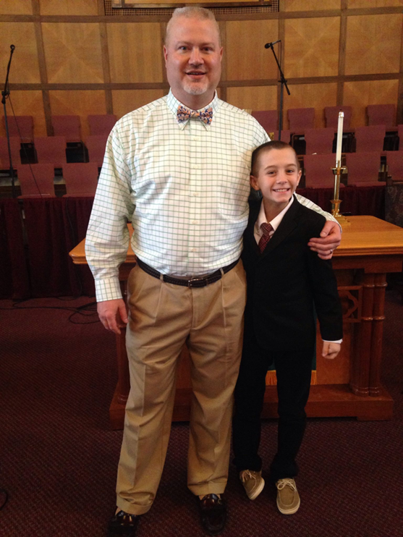

Slide 20
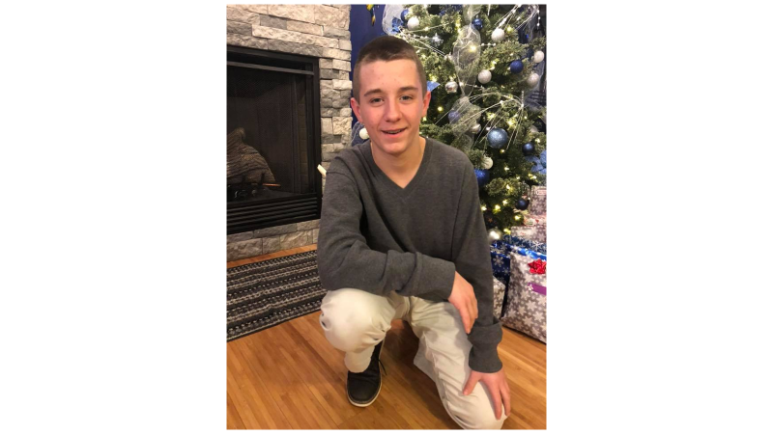

Slide 21
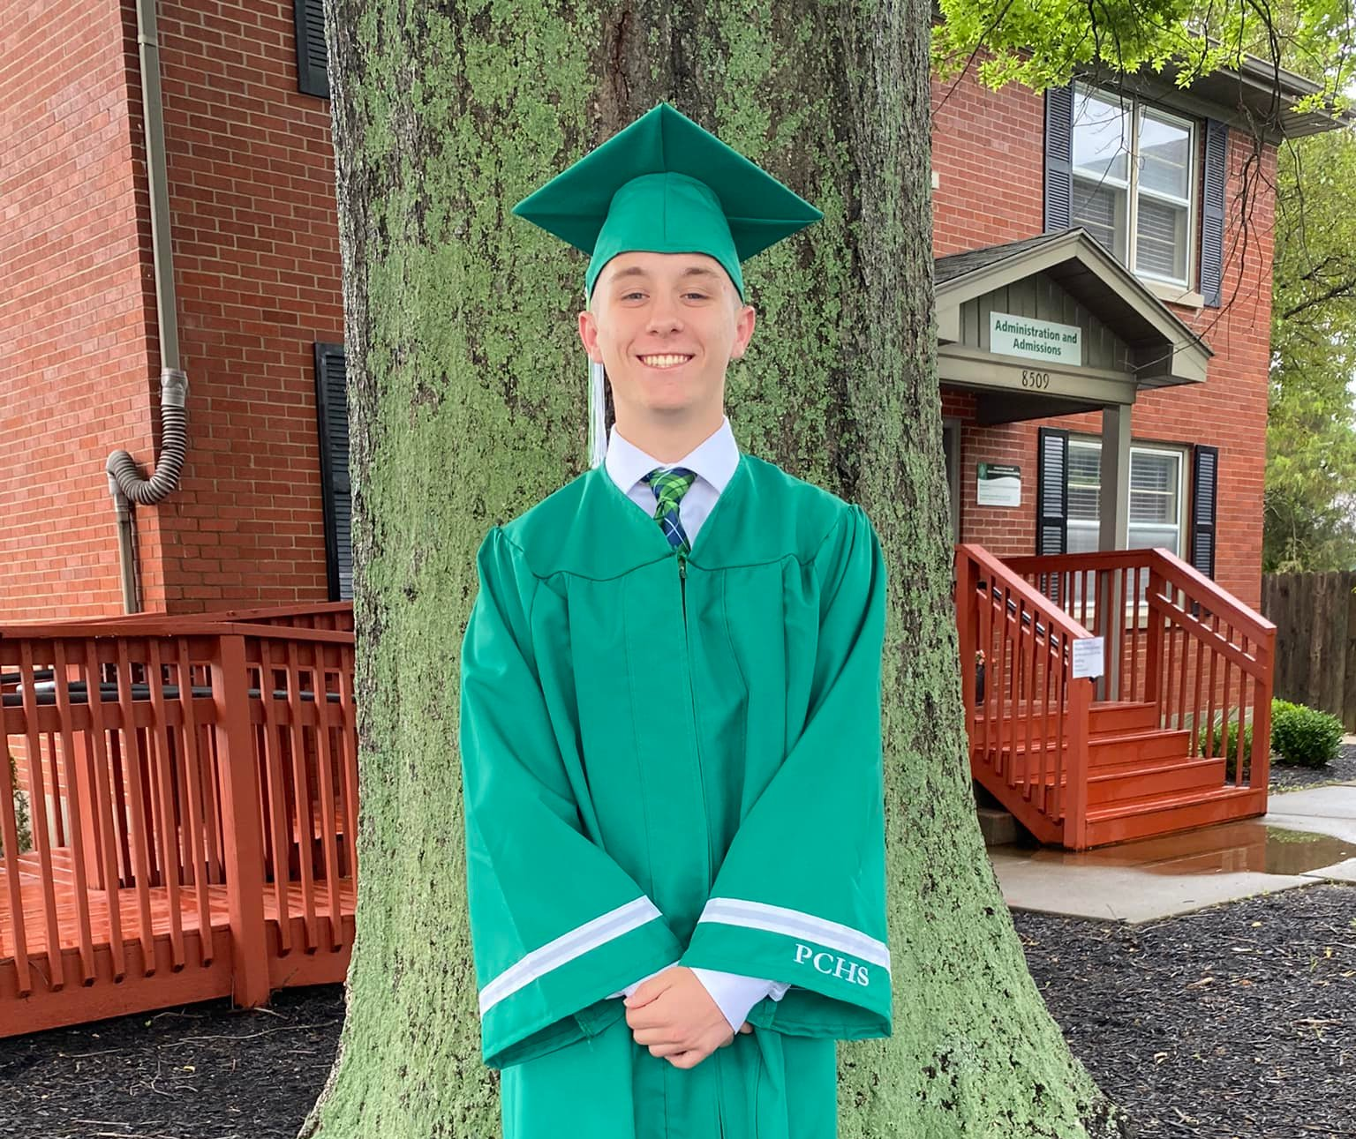
“Finally, we thank those who have helped along the way. It takes a village, and he has an amazing tribe. In the face of tremendous odds, you did it!”

Slide 22
Every aspect of our church needs to rediscover their “why” and understand how it connects to making disciples.
This includes Safer Sanctuaries
Notes:
How do refocus?
How do we bring clarity to everything that we do, so we all know how it contributes to our mission of making disciples?

Slide 23

Holistic
Adjective
Characterized by the belief that the parts of something are interconnected and can be explained only by reference to the whole.

Slide 24
All About Relationships
Can you distinguish the difference in offering a policy versus nurturing relationships?

Slide 25

Reasons to implement
Not if it happens,
but when it happens

Slide 26

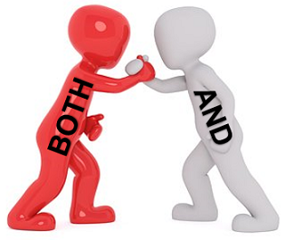
Both/And

Slide 27
“Why”
Protect the children from abuse.
AND
Protect staff and volunteers from unfounded accusations.

Slide 28

Extra, Extra
How to avoid front page news when accusations, whether true or false, occur.

Slide 29

Make the Shift
Paradigm shift from legal language to ministry opportunity.
This includes transparency, vulnerability, and honesty.

Slide 30
WONDER
How do I create congregational buy-in to implement/update a Safer Sanctuary policy?

Slide 31
What makes the risk for churches especially high?
Churches behave as relatively trusting organizations, relying upon their members and their leaders to conduct themselves appropriately.
Too often, this trusting attitude persists even in the face of questions or reports of misconduct. The truth is that approximately 90% percent of the reported incidents of abuse are perpetrated by an individual that the child already knows and trusts. (www.d2l.org) This indicates that child may be targeted by persons they know and trust at church.

Slide 32
What makes the risk for churches especially high?
Churches routinely provide opportunities for close contact and for close personal relationships with children and youth. Indeed, they are nurtured and encouraged as we try to live out the gospel message.
Churches are notoriously inactive when it comes to screening volunteers and/or employees who work with children and youth. Too often, no application is used, and no references are checked at all before a total stranger is welcomed aboard.

Slide 33
Reasons to implement
Offer a safe haven.
Teach/model justice and compassion.
Provide a place to truly connect in a healthy manner.
Respond to painful scripture passages.

Slide 34
Ministries, Programs, Events, Activities
System/Pathway (unique)
Culture (Discipleship)

Slide 35
WONDER
How would you describe
the current Safe Sanctuary system in your church?

Slide 36
WONDER
How would someone else describe
the current Safe Sanctuary system in church?

Slide 37
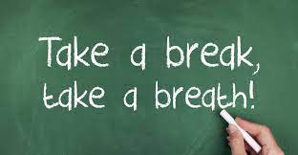

Slide 38

Recognizing the signs of abuse

Slide 39
True or False
Use your emojis to provide thumbs up or thumbs down.
Notes:
Let’s take a quiz. The questions below are based upon reported statistics.

Slide 40
Child sexual abuse is isolated to specific socioeconomic factors.
Notes:
Question one, Child sexual abuse is isolated to specific socioeconomic factors. Is this true or false?

Slide 41
Child sexual abuse is isolated to specific socioeconomic factors.
FALSE – While socioeconomic factors can contribute to sexual abuse it happened in all spears of life.
Notes:
This statement is false. While socioeconomic factors can contribute to sexual abuse, sexual abuse happens in all sectors. This is regardless of income, location, race or ethnicity.

Slide 42
Most sexual abuse cases are false accusations
Notes:
Number two, Most sexual abuse cases are false accusations. True or false.

Slide 43
Most sexual abuse cases are false accusations
False – only 2-10% of all people who file sexual abuse complaints are found to be false.
Notes:
This statement is false. As a matter of fact, only two to ten percent of all people who file sexual abuse complaints are found to be false. This means that we should take accusation of sexual abuse and all abuse and neglect seriously.

Slide 44
Parents are responsible for a vast majority of all abuse types.
Notes:
Next question, Parents are responsible for a vast majority of all abuse types.

Slide 45
Parents are responsible for a vast majority of all abuse types.
True - 9/10 survivors of all abuse types were abused by one or both parents.
Notes:
This statement is true. Nine of ten survivors of all abuse types were abused by one or both parents. Parents are most likely to abuse a child because they are the ones who most likely have unsupervised interactions with the child. It is a matter of who has access to the child.

Slide 46
The majority of sexual abuse perpetrators are men, although women can also be perpetrators
Notes:
The majority of sexual abuse perpetrators are men, although women can also be perpetrators. Do you think this is true or false.

Slide 47
The majority of sexual abuse perpetrators are men, although women can also be perpetrators
True - Sexual abuse perpetrators are female in 1 of 5 cases.
Notes:
This statement is true. Sexual abuse perpetrators are female in one in five cases, which means men are perpetrators in eighty percent of the cases. While most perpetrators are men, it does not preclude women from being sexual abuse perpetrators.

Slide 48
Children are prone to report sexual abuse immediately
Notes:
The final question. Children are prone to report sexual abuse immediately.

Slide 49
Children are prone to report sexual abuse immediately
False - Most children delay reporting sexual abuse or never report it at all.
Notes:
This statement is false. Most children delay reporting sexual abuse or never report it at all. There are several factors related to this. Many children have no frame of reference for sexual abuse. In addition, a child who may understand sexual abuse may have a deep feeling of shame because of the pleasurable nature of the sexual abuse.

Slide 50

Notes:
How did you do. Regardless of how many you got right or wrong you did great because you learned something new. Keep up the good work. Maybe this short quiz helped expose some biases you have about how abuse occurs.

Slide 51
Realities
Finding common language, identifying, and understanding the signs and symptoms.

Slide 52
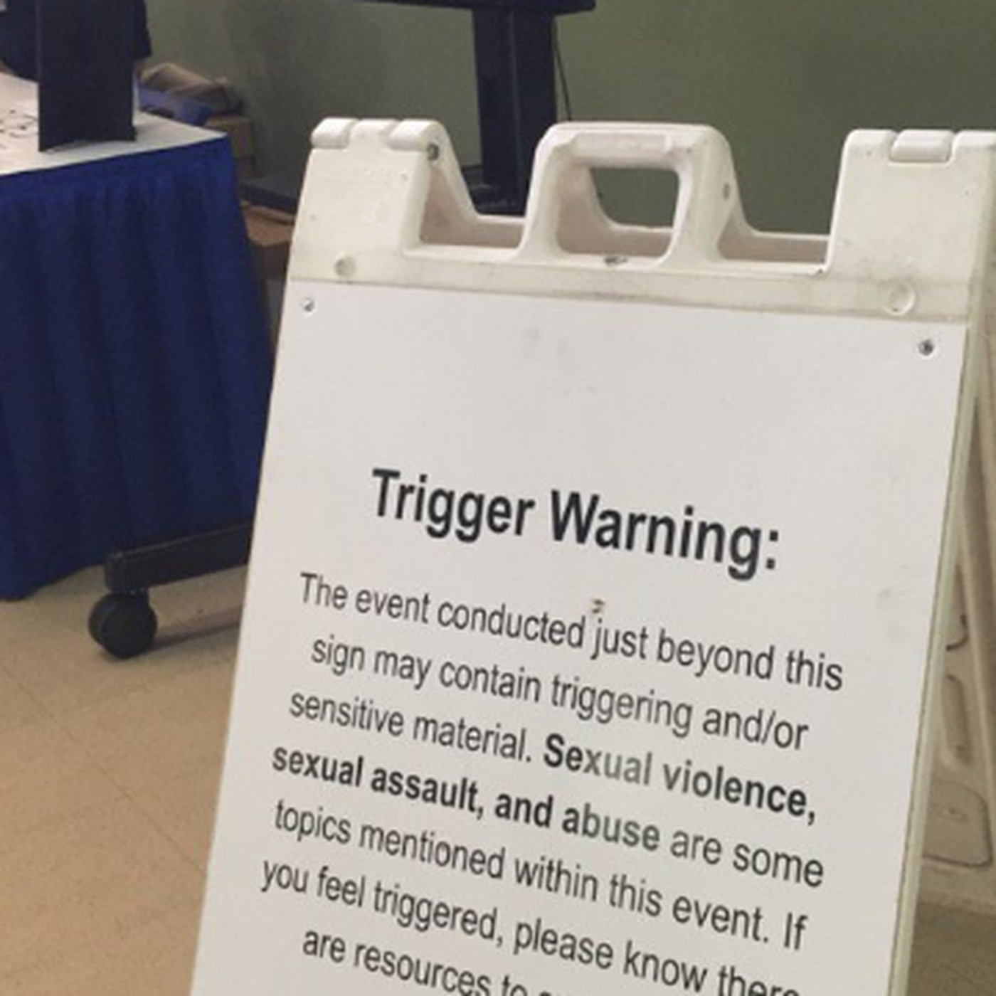

Slide 53
The statistics are alarming
In just two weeks, there were reports including: the sexual molestation of middle school students by a trusted teacher; the sexual abuse of a teenage boy by a drifter already on probation for the sexual molestation of a minor; the sexual molestation of a preschooler by her step- father; the pornographic exploitation of a preschooler by her parents, who offered the child to acquaintances in exchange for cocaine; and the sexual abuse of a preschooler by a Sunday school teacher. The abuse happened not in dark, isolated alleys but in the child’s home, the child’s daycare center, the child’s school classroom, the child’s summer camp, and the child’s church. The identities of the alleged abusers ranged from parents, to aunts and uncles, to family friends, to teachers, to childcare workers, to camp counselors, to Sunday school teachers, to complete strangers. Today, according to the Center for Missing and Exploited Children (www.missingkids.com), one in every five children under 18 will be solicited for sex acts on-line.

Slide 54
Abuse
Physical Abuse
Emotional Abuse
Neglect
Sexual Abuse
Spiritual Abuse
Financial Abuse
Elder/Caregiver Abuse
Domestic Violence

Slide 55
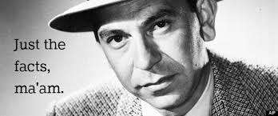
Just the Facts
Physical: abuse in which a person deliberately/intentionally causes bodily harm to child
According to the CDC, approximately 1 in 7 children have experienced child abuse or neglect in the past year and In 2020, approximately 1,750 children died of child abuse or neglect. This is likely an underestimate because many cases are unreported.

Slide 56

Abuse
Neglect: abuse in which a person endangers a child’s health, safety, or welfare through negligence. This is a frequently reported type of child abuse and is often very difficult to substantiate.
Nevertheless, the CDC reports that 1 in 7 children have experienced child abuse or neglect in the past year.

Slide 57
Abuse
Emotional: abuse in which a person exposes a child to spoken and/or unspoken violence or emotional cruelty, sending a message of worthlessness, badness, and being undeserving of love

Slide 58
Abuse
Sexual: abuse in which sexual contact between a child and adult (or another more powerful youth) occurs. The child is never truly capable of consent to sexual contacts. Every state defines sexual abuse in multiple ways, such as sexual assault, rape, and statutory rape.

Slide 59
Abuse
Ritual: abuse in which physical, sexual, psychological violations of a child are inflicted regularly, intentionally, and in a stylized way by a person(s) responsible for child’s welfare. The perpetrator may appeal to some higher authority/power to justify the abuse. Ritual abuse is probably the least often reported type of child abuse and is not usually specifically and separately defined by statutes.
However, ritual abuse does occur in church settings, and it is important for those in ministry to recognize.

Slide 60
Abuse
Financial abuse:
Includes theft, fraud, misuse or neglect of authority, and use of undue influence as a lever to gain control over an older person’s money or property.
This is the most common form of elder abuse. This occurs from both family members and from strangers.

Slide 61
Recognizing Abuse
(Cover in your training)
1ST Step – Learn to recognize the signs of child abuse & neglect.
Presence of a single sign does not prove child abuse is occurring.
A closer look at the situation may be warranted when these signs appear repeatedly & in combination.
Child Welfare Information Gateway – www.childwelfare.gov

Slide 62
Recognizing child abuse – The Child
Sudden changes in behavior or school performance.
No help for physical or medical problems brought to parents’ attention.
Lacks adult supervision.
Child Welfare Information Gateway – www.childwelfare.gov

Slide 63
Recognizing child abuse – The Child
Learning problems/Difficulty concentrating that cannot be attributed to specific physical or psychological causes.
Always watchful.
Overly compliant, passive or withdrawn.
Comes to school or other activities early, stays late, and does not want to go home.
Child Welfare Information Gateway – www.childwelfare.gov

Slide 64
Recognizing child abuse – The Adult
Shows little concern for the child.
Denies the existence of—or blames child for—the child’s problems.
Asks caregivers to use harsh physical discipline if the child misbehaves.
See child as bad, worthless or burdensome.
Child Welfare Information Gateway – www.childwelfare.gov

Slide 65
Recognizing child abuse – The Adult
Demands a level of physical or academic performance that the child cannot achieve.
Look primarily to the child for care, attention, and satisfaction of emotional needs.
Child Welfare Information Gateway – www.childwelfare.gov

Slide 66
Recognizing child abuse – Child & Adult
Rarely touch or look at each other.
Consider their relationship entirely negative.
State that they do not like each other.
Child Welfare Information Gateway – www.childwelfare.gov

Slide 67
Signs of Sexual Abuse – The Child
Has difficulty walking or sitting.
Suddenly refuses to participate in physical activities.
Reports nightmares or bedwetting.
Experiences a sudden change in appetite.
Child Welfare Information Gateway – www.childwelfare.gov

Slide 68
Signs of Sexual Abuse – The Child
Demonstrates bizarre, sophisticated, or unusual sexual knowledge or behavior.
Becomes pregnant or contracts a venereal disease.
Runs away.
Reports sexual abuse.
Child Welfare Information Gateway – www.childwelfare.gov

Slide 69
Signs of Sexual Abuse – The Adult
Unduly protective of the child.
Severely limits the child’s contact with other children.
Secretive & isolated.
Jealous or controlling with family members.
Child Welfare Information Gateway – www.childwelfare.gov

Slide 70
Signs of Ritual Abuse
1. Disruptions of memory or consciousness
2. Unexplained mistrust and mood swings
3. Flashbacks
4. Eating disorders
5. Fear of the dark, especially at sundown or a full moon
6. Agitation or despair that seems to occur in cycles
7. Fear of ministers, priests, or others wearing robes or uniforms
8. Nightmares or sleep disorders
9. Any of the symptoms of sexual abuse

Slide 71


Slide 72

Attunement
Attunement describes how reactive a person is to another's emotional needs and moods. A person who is well attuned will respond with appropriate language and behaviors based on another person's emotional state. They are good at recognizing moods and emotions in another person and adapting their own response in accordance. Well attuned parents are important in that they are able to detect what their babies are feeling or thinking and respond appropriately.

Slide 73
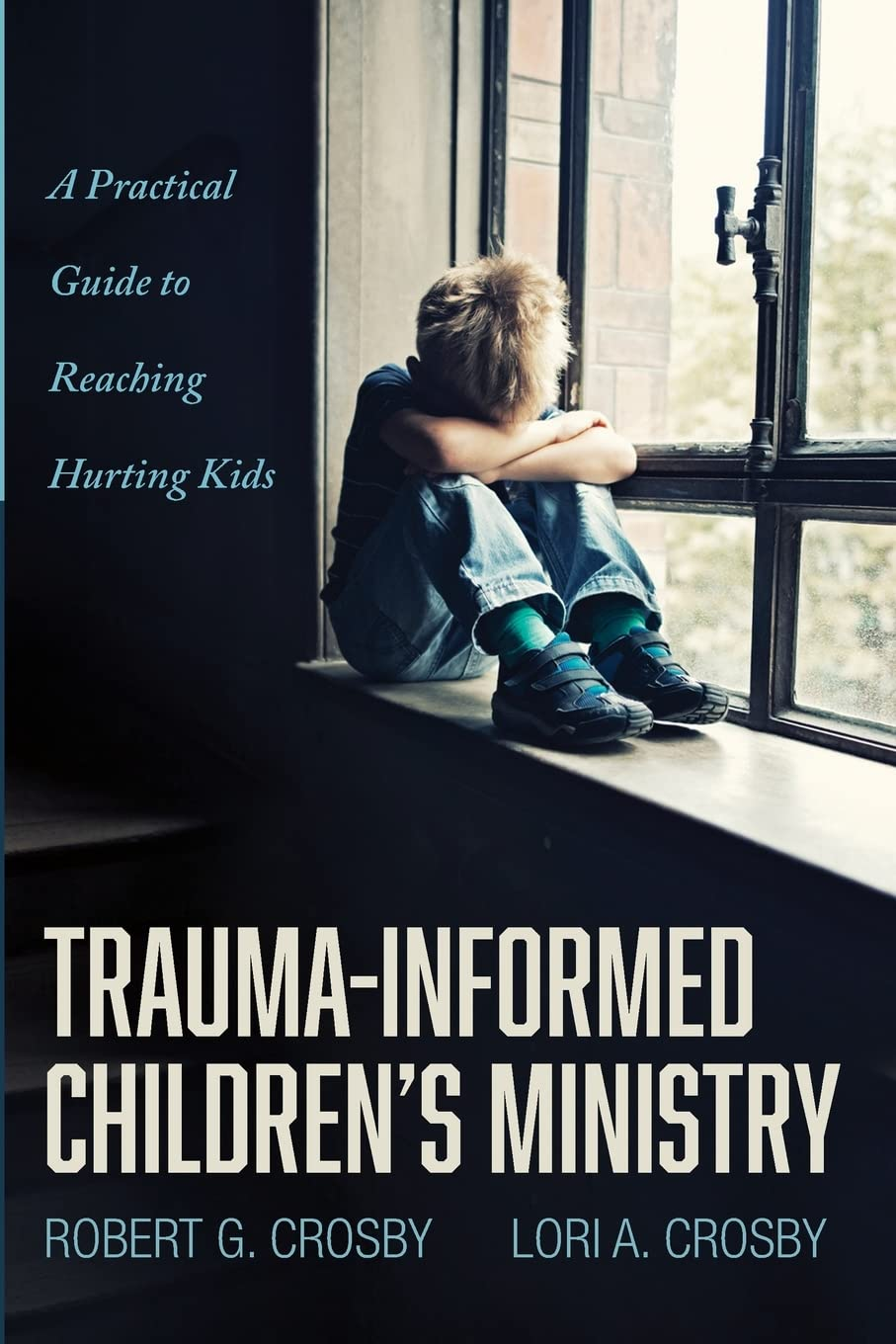
Trauma –Informed Children
Give children goals to aim for—and show them how to achieve those goals.
In children who’ve experienced trauma, misbehaviors are often unhealthy coping mechanisms to a situation they don’t like or that makes them uneasy.
Train your team to intentionally empower kids by showing them how to be successful and by having a voice in what’s happening.
Use discipline situations to teach kids new and healthier ways to express their feelings.
Use storytelling, role play, or discussion to illustrate how Bible people experienced hardship—and how God worked through the situation.
Provide children and parents the tools, examples, and support they need to succeed.
Understand the terminology of ACE – Adverse Childhood Experiences. Most likely you will encounter many ACE’s in your ministry context.

Slide 74
Adverse Childhood Experiences
(ACE)
Adverse childhood experience or ACE is defined as a harmful event or events in the life of a child under the age of 18. This can include incidents of abuse, neglect or even household difficulties. So even if a child was not abused or neglected the child may have still had difficulties such as financial hardships, having a parent incarcerated, mental health challenges or being in a home where abuse and neglect occur but the child was not a victim of.
Adverse childhood events can affect brain development and are linked to chronic health problems and substance misuse as an adult.

Slide 75
Recognizing abuse(rs)
Who are they?
What is grooming?
Bullying (cyberbullying)

Slide 76
Beyond clinical terminology
Nicknames
Sunburn (especially in youth ministries context)
Others?

Slide 77


Slide 79
Four-Part Policy
Screening
Supervision
Reporting
Responding

Slide 80
WONDER
What are some first steps in screening volunteers in your ministry context?

Slide 81



Slide 82



Slide 83
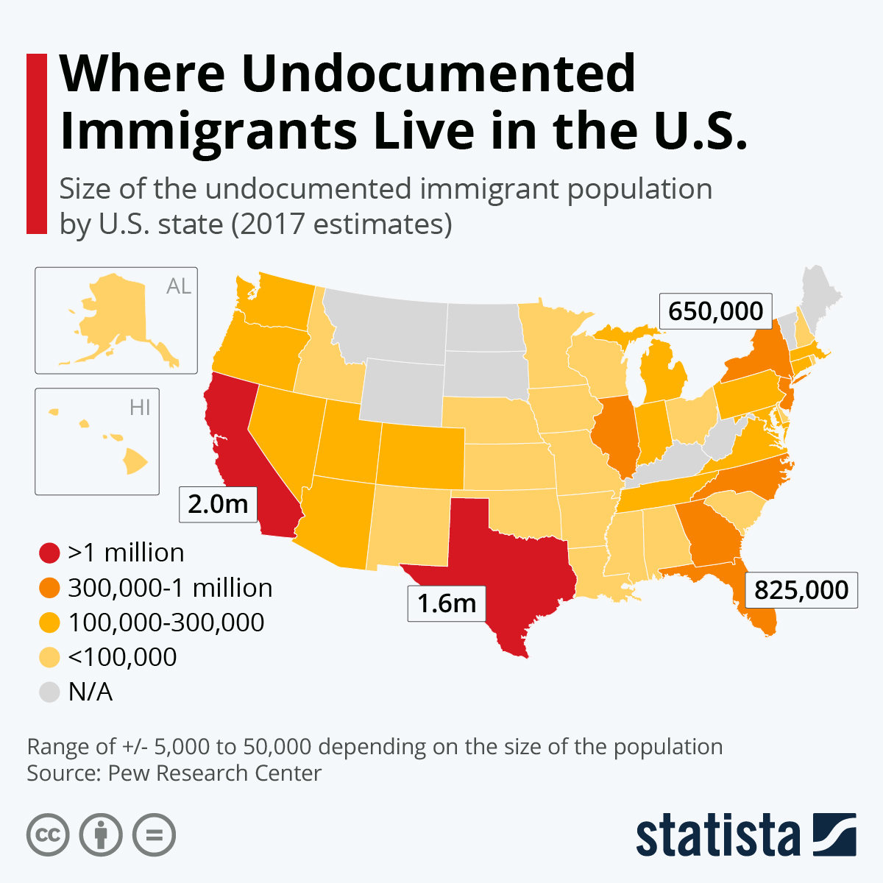

Slide 84
Screening
The Specifics to who is volunteering

Slide 85
First Steps: Screening
Define your needs: where?
Recruit the right volunteers: who?
Research those individuals: how?

Slide 86
Screening
All workers (paid and volunteer) complete a BACKGROUND SCREENING FORM.
REFERENCES will be contacted.
BACKGROUND CHECKS must be processed – Repeat every 2 years (annually if you live in transitional context).

Slide 87
Screening
Must be active with the church at least 6 months prior to supervising children/youth.
Define “membership” in your context.
New staff hires – References will replace 6 month waiting period.

Slide 88
DISCUSS
How would you respond?
A registered sex offender wants to come to worship and participate in the ministries of your church?

Slide 89
Supervision
How to Supervise

Slide 90
WONDER
Share your understanding of supervision in a Safer Sanctuary policy.

Slide 91
Supervision
Goals
Roles
Expectations
Abilities
Time

Slide 92

Consider the Following
Best Practices
Rule of Three
Transportation
Public Place
Bathrooms
Gender/Sexuality Issues
Third Parties Using Church Facilities.

Slide 93
Supervision
Participate in annual TRAINING for staff & volunteers.
All ministries should occur in OPEN VIEW. Window, half door (Dutch door), or door shall remain open.

Slide 94
Supervision
2 Adult Rule. There will be 2 unrelated adults in each classroom no matter the size of the group.
If this is not possible, there will be a “roamer” who moves amid the rooms during the program period.

Slide 95
Supervision
No one vulnerable will be left unsupervised.
Monitor area of ministry at all times.
(Let’s talk about restrooms)
REGISTRATION MATERIALS should be collected for all activities & PERMISSION FORMS for transportation.

Slide 96
Supervision
Must be 18 OR OLDER in order to supervise younger children.
Those over 18 must be at least 5 YEARS OLDER THAN THE CHILDREN.
“Putting children in charge of children invites disaster.”
Joy Melton “Safe Sanctuaries.”
Covenant agreement and participation/expectations.

Slide 97

How do we supervise…
Nursery
Children’s ministries with shared preschool classroom space
Youth groups (online and in person)
Youth retreats
Mission trips
Adults with developmental/physical disabilities
Elderly (Shut ins) visitation
Weekday preschool
Camping ministries
LGBTQIA+
others…

Slide 98

What about outside agencies?

Slide 99
WONDER
What is my responsibility (and my response) for third party organizations that use church property?

Slide 100
WONDER
How do we embrace a holistic approach to ministry supervision?

Slide 101

What is expected

Slide 102
Need to know
What is my responsibility for reporting abuse or allegation of abuse?

Slide 103
Reporting
Reporting is REQUIRED by any staff or volunteer:
that personally witnesses an incident of abuse or exploitation.
when an allegation of an event of abuse or exploitation is made to staff or a volunteer by a third party.
when a child/vulnerable adult discloses abuse or exploitation.

Slide 104
Reporting
IMMEDIATELY report the incident/suspected abuse to the person in charge of the ministry/activity.
The person in charge then informs the Pastor in charge & contacts the local Child Protection Hot Line/State Police.
If the ACCUSED is CLERGY, OR THEIR FAMILY, the District Superintendent (DS) will be contacted immediately.
Keep a WRITTEN RECORD of the event. (if it isn’t documented, it didn’t happen).

Slide 105
When it comes to reporting, remember…
Mandatory
It is not our job to dismiss
Just the facts
Time period to report
Unified
3 types of reporting:
real-time, something happens at home [imminent danger], tales of past [past trauma]
Crisis team
Train leaders to not withhold secrets.

Slide 106



Slide 107
Responding
Is there a difference between reacting and responding?

Slide 108

Responding
Quickly
Compassionately
Unified
No cover ups

Slide 109
Responding
Victim’s safety is the first concern!
Treat the accused with dignity, but immediately & discreetly remove them from further involvement with children and/or youth.
Pastoral support will be available to all involved.

Slide 110

RESPONDING
Taking a pastoral eye

Slide 112

VIRTUAL SAFETY
Approach online ministry opportunities the same way you would in-person opportunities.

Slide 113
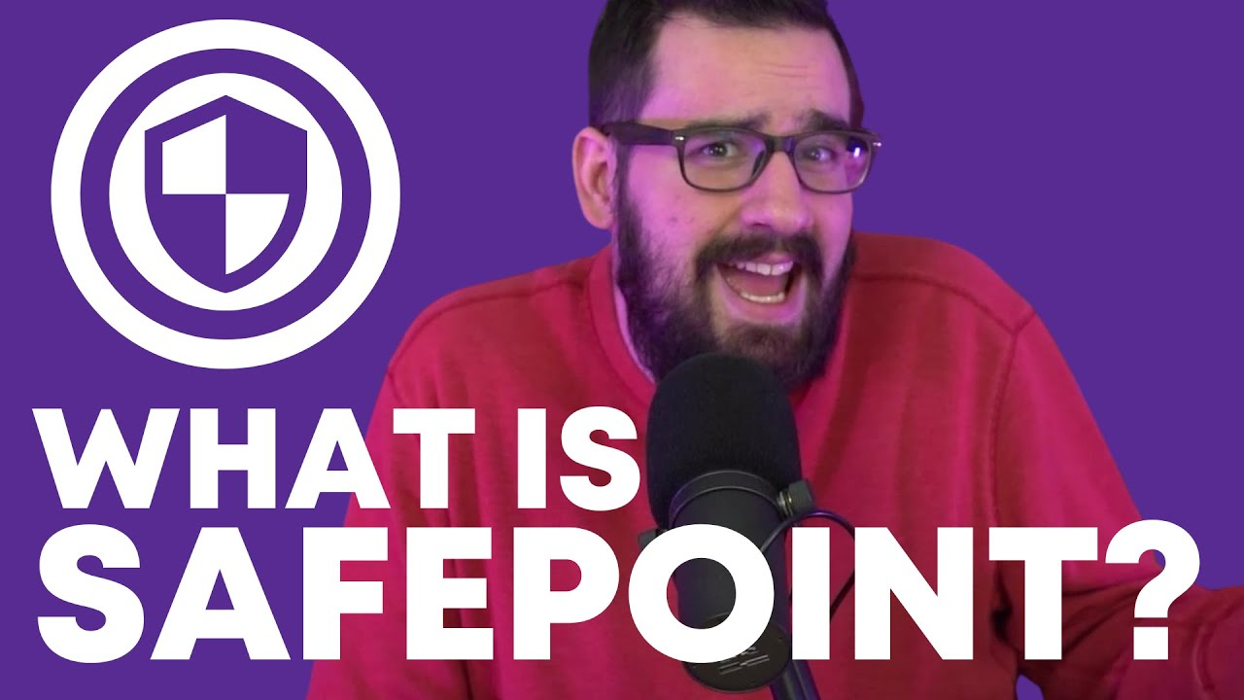
Cyber Safety
Keeping our children and youth safe with technology
See https://www.checkpointchurch.com/.

Slide 114

Document, document, document!
(Even online)
Keep a WRITTEN RECORD of the event.
(If it isn’t documented, it didn’t happen).

Slide 117
Policy Build
Let’s build a policy.
Let’s live into a ministry opportunity.

Slide 118
First steps in policy creation
Form a Safe Sanctuaries Committee. (You’re not in this alone).
Claim your “why”
State your theology to support.
(Baptism)
Define terminology
Language used
Scope. (Where will this policy be applied)?
Who are your champions?
Have legal counsel on board
Make contact with CPS/State Police

Slide 119
Physical buildings and barriers
One of the first things recommended is to take an inventory of the physical building and rooms used for your ministry event. When entering the area familiarize yourself with the surroundings.
(always keep in mind)…
  How would you describe the current Safe Sanctuary system in your church?
  How would someone else describe the current Safe Sanctuary system in church?

Slide 120
Physical barriers
(Trustees can help)
As you approach the area, are there any vision impairments in the hallways leading to the room?
What does the door into the room look like? Is there a window? Can you see through it? Is there a half door (Dutch door)?
Where is the nearest restroom, both boys and girls?
Upon entering the room, are there any “hiding” spots?
Are all the windows sight lines clear?
How many entry/exits points are there into the room? From the room itself?
What should the room look like for your event?
Are there any physical barriers for wheelchair users?

Slide 121
Policy should address
(Remember the 4-parts)
Screening
(Selection)
Liability/insurance coverage
Background checks
Youth volunteers

Slide 122
Policy should address…
Supervision
(Training)
Activity procedures
Individual counseling
Youth volunteers
Transportation
Social-Media
Off-site
overnight
Third parties

Slide 123
Policy should address…
Reporting
Document!
Mandatory
reporting
Who reports/and to whom?
Response
Pastoral
Interaction with the media?
Review and revise

Slide 124

A Holistic approach…
When creating a policy ideas should include…

Slide 125
When embracing a holistic approach…
Research and learn about abuse in your community.
Determine your level of need, including barriers that you face.
Evaluate your current practices.
Develop new (or update) policies.
Create a plan for recognition and response.
Churchwide adoption of policies and procedures.
Educate entire congregation.
Review and revise plan
Create a Crisis Team

Slide 126


Pastoral eye will change culture

Slide 127

Consistently and Constantly

Slide 128

Create Champions

Slide 129

Appoint Go-To Person(s)

Slide 130
Document, document, document!
Keep a WRITTEN RECORD of the event.
(If it isn’t documented, it didn’t happen).

Slide 131

Essential Updates
The essential updates to your current approach and content to include annual training materials.

Slide 132

Review and Revise

Slide 133

Create a Plan for Recognition and Response

Slide 134
Finally
I wonder how your faith community will implement and live into this ministry.
(Do what you say you will do)!

Slide 135

Live the Policy
Do what you said you would do

Slide 136
Matthew 25:40
40 “The King will reply, ‘What I’m about to tell you is true. Anything you did for one of the least important of these brothers and sisters of mine, you did for me.’

Slide 138

“Be” An Example

Slide 139

Closing Prayer
Leader: O God, by our presence here today,
People: We welcome ALL God’s children, as we’re all vulnerable!
Leader: O God, by our promise in Holy Baptism,
People: We welcome ALL God’s children, as we’re all vulnerable!

Slide 140
Closing Prayer
Leader: O God, by our participation in the ministries of this congregation,
People: We welcome ALL God’s children, as we’re all vulnerable!
Leader: O God, by our commitment to keeping this place holy and safe in every way,
People: We welcome ALL God’s children, as we’re all vulnerable!

Slide 141

Closing Prayer
Leader: O God, give us wisdom, strength, and courage enough to show the world that
People: We welcome ALL God’s children, as we’re all vulnerable!
All: Amen!

Slide 142
It’s Not About Fixing Churches.
SeeAllThePeople.org

